Slide 1
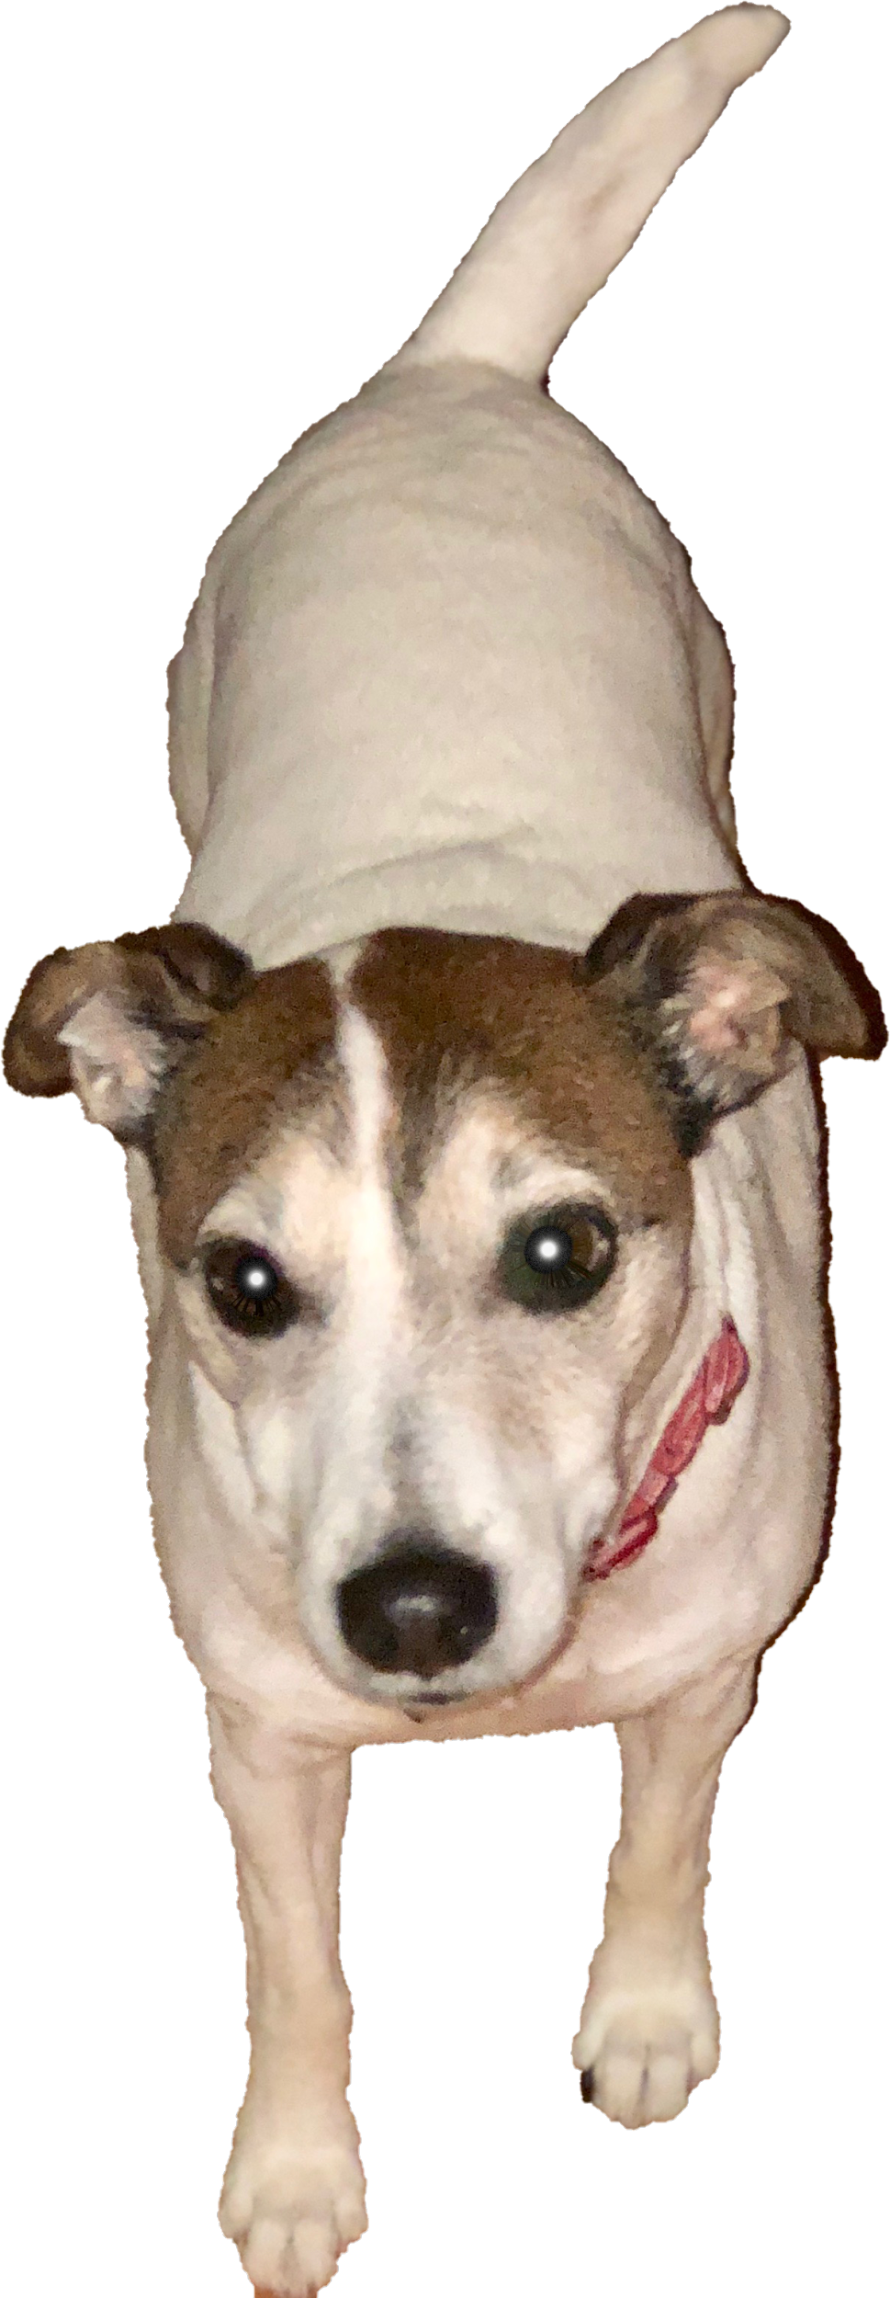
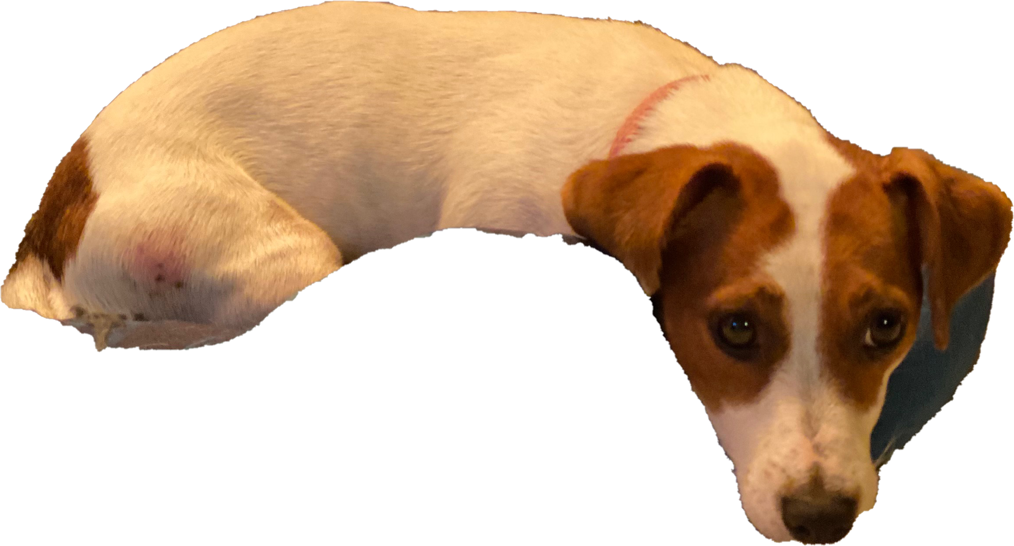
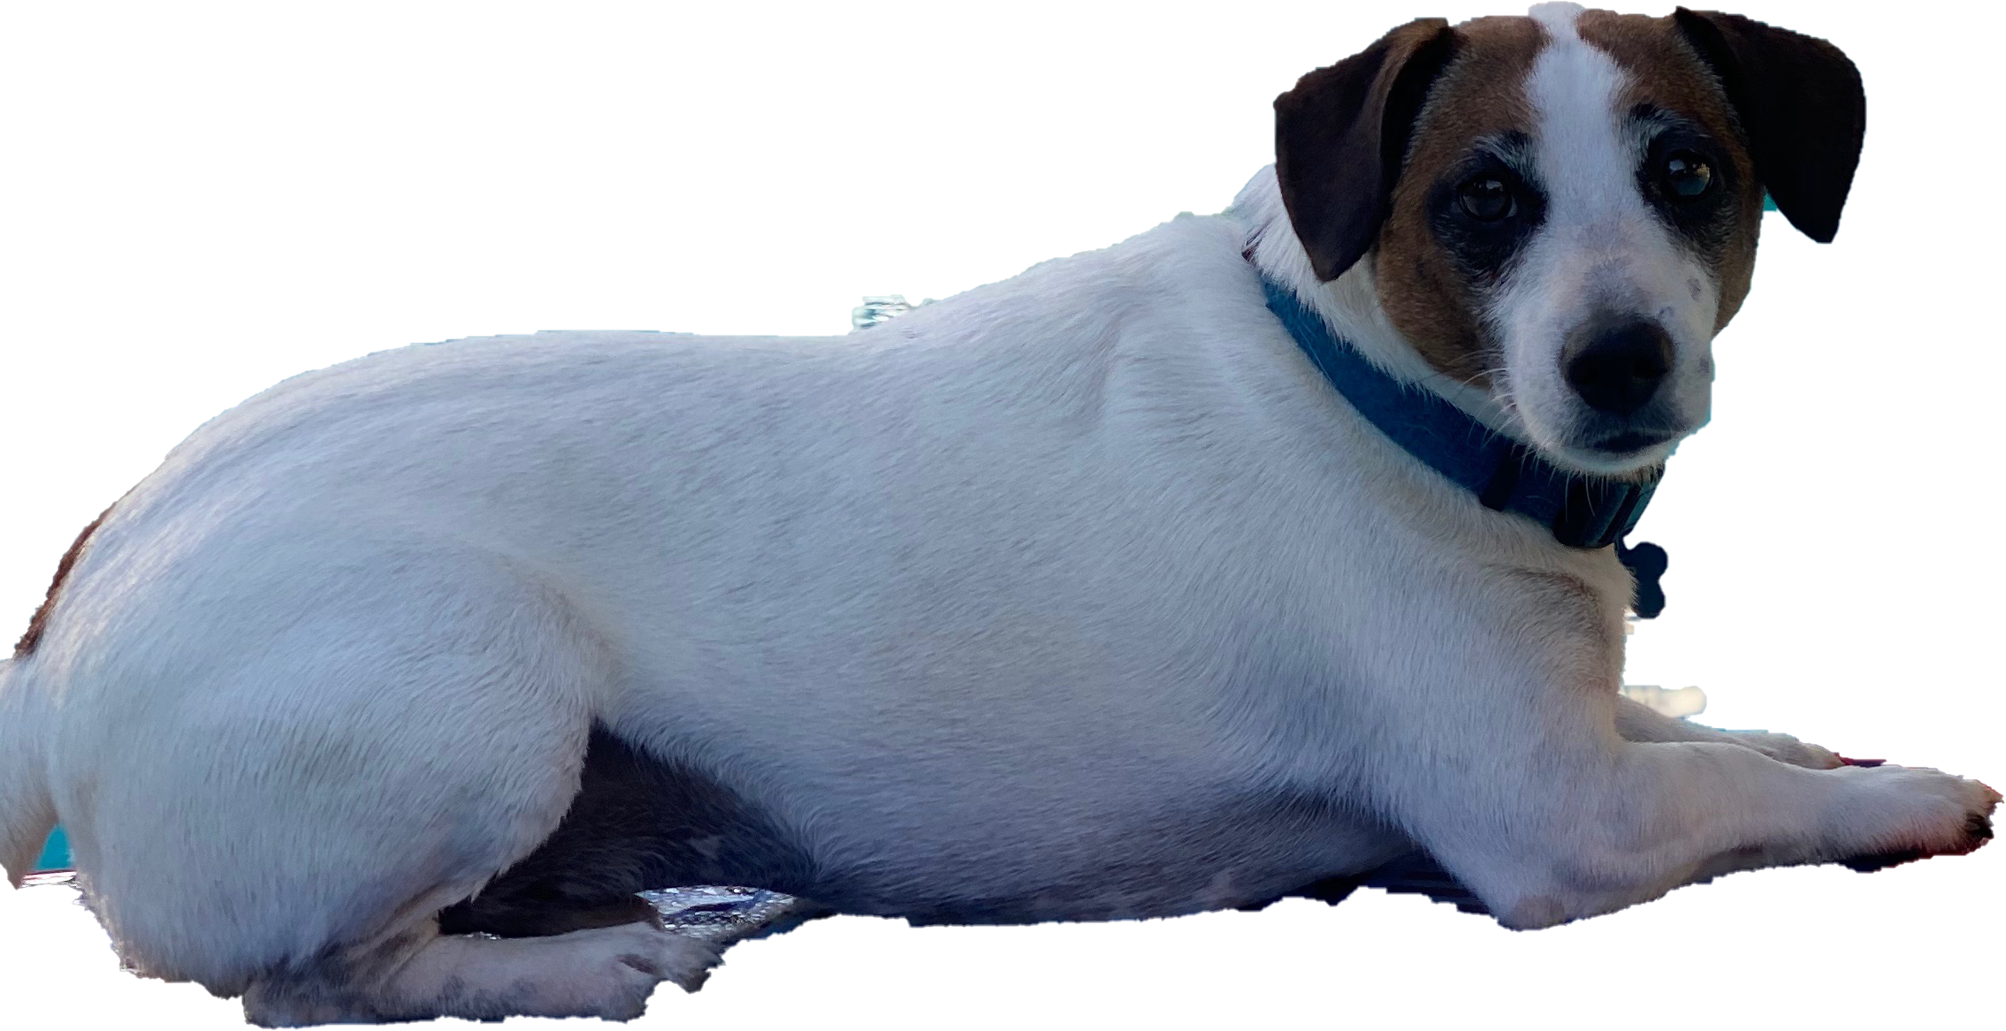
Hi! Welcome to the 2022-2023 School Year! I am Brynn Wallace, the 5th Grade Team Leader. I teach 4 blocks of science! In my 21 years of teaching, I’ve taught 5th grade science 12 of those years, so it has truly become a passion of mine! My goal is to provide a fun, safe, and hands-on learning environment!
A bit of personal info….I am happily married to my husband of 17 years, and we have a daughter in 8th grade this year! We also have three Jack Russell Terriers, Trubador, Jax, and Gemma!
I am so excited for this school year! I can guarantee our 5th graders will have a year they will cherish and never forget!
If ever you need to reach out to me, please call the school at 850-488-3301 or email me at wallaceb@leonschools.net

